Slide 1
Coordinating Failed Goods Collecting Policies and Repair Capacity Policies in the Maintenance of Commoditized Capital Goods
Henny P.G. van Ooijen
J. Will M. Bertrand
Nasuh C. Büyükkaramikli
Notes:
I’m gonna talk about integrating policies; it is joint work with Will Bertrand and based upon work of my PhD Cagdas
The setting is that we focus on a repair shop that is responsible for the uptime of certain capital goods in a certain region; The captial goods or parts of them regularly break down and then have to be collected and repaired.

Slide 2
OUTLINE
Background
  Commoditized systems
  Repair shop
  Collecting policies
  Capacity policies
Model
Computational study
Conclusions

Slide 3
COMMODITIZED SYSTEMS
High number of end users
Low technological/financial barriers -> easy entry of repair market
Short term availability of substitutes (e.g. by leasing)
Notes:
failures come from an infinite population of systems and follow a Poisson process with a constant arrival rate $λ$

Slide 4
REPAIR SHOP
Repair shop (Maintenance Service Provider)
  Maintenance service for commoditized systems
    failure due to (sub-)system failure
  Defective systems are replaced by rented systems for a fixed time
  Responsible for downtime
  Repair shop characteristics
    capacity of the shop determines the speed of repair;
      capacity level: the processing rate

Slide 5
Collecting Policies
Immediate collection
Periodic collection (milk run)

Slide 6
Capacity Policies
Availability based policy:
  There is always a fixed amount of capacity available
Usage based policy
  Periodic capacity contract
    A specific amount of capacity is available at the start of a period
    Only paid for in proportion to the hours the capacity is used during the period
Notes:
Research: Inv. Control of repair items: a lot of research:
Ample repair capacity
Some incorporate QNT -> comp. complexity of perf. Eval. Of CQN
Flex. Cap./manpower in rep. Item systems: rather understudied (if so, then simulation)
Buyukkaramikli: Continuous release, two level capacity mode
Lead time and on time delivery constraints.

Slide 7
Research Question
For what environments does periodic collection whether or not in combination with a usage based capacity policy lead to “overall” benefits?

Slide 8
Problem
Given
  An overall failure rate λ,
  transportation costs t_{c}
  capacity costs (permanent c_{p}, contingent c_{c})
  machine downtime costs B
  system rental costs (h_{τ}),
  a capacity sell-back ratio R,
minimize total costs by decisions on:
  transportation policy
  capacity policy
    terms of the capacity contract (level, period length)
  rental period L

Slide 9
Model I: tranportation costs
Immediate collection:
Periodic collection

Slide 10

Model II: capacity costs
  Availability based:
  Repair shop: M/M/1
Usage based:
  Repair shop: D_{X}/M/1
$c_{c}=c_{p}+\frac{∆}{1+α}$
Notes:
Solved by a Search procedure: for different values of L and D we determined the optimal μ;
using simulation we determined the expected downtime of the systems in the field.

Slide 11
COMPUTATIONAL STUDY (I)
Cost price system: € 200.000
Normalized arrival rate: λ=1 per time unit (week/day)
defects
System renting cost: h=€11, €15, €20 per hour
Downtime cost: B=€5000, €10000, €20000 per unit down per week
Capacity costs: c_{p}= €2400 per unit
Sell-back parameter: R=0.2, 0.5, 0.8
Transportation costs: €90, €120 per hour
Area size: 300.000 sqm, 1.000.000 sqm
Notes:
Based on a practical setting, using systems that cost ca. €200.000
Radius: 310; 565 km

Slide 12
COMPUTATIONAL STUDY (II)
Immediate collection, availability based capacity
                ⬄
Periodic collection, availability based capacity
Immediate collection, availability based capacity
                ⬄
  Periodic collection, usage based capacity
  % Cost savings: (TRC*_{i} – TRC*_{p})/TRC*_{i}

Slide 13
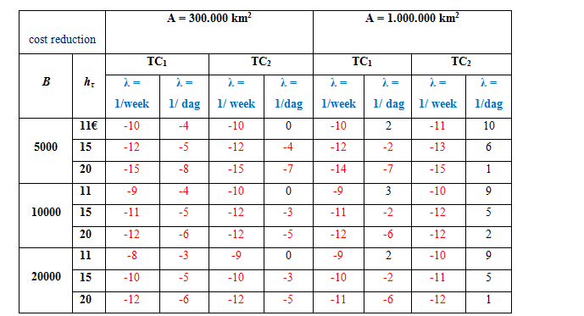
RESULTS (I)
Notes:
Red: negative effects

Slide 14
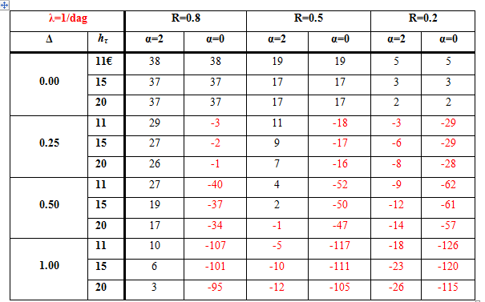
RESULTS (II)
Notes:
Red : negative effects

Slide 15
CONCLUSIONS (I)
Transportation point of view: periodic collection always leads to benefits; benefits increase with increasing λ
Also customer related aspects included: positive effects are canceled out by extra rental
Also MPS aspects included:
  Availability policy: decrease positive effects due to bursty arrival pattern (unless a high λ)
  Usage policy: benefits can be obtained for smaller values of λ (λ = 1: up to 38% cost reduction)
some cost parameter instances: loss in savings (up to 126%)
Notes:
Flexibility makes systems more robust both for changes/wrong estimates of the cost parameters, as well as for changes/wrong estimates for the demand rate.

Slide 16
CONCLUSIONS (II)
Usgae based policy often outperformed by the availability based policy
% savings increase with increase in α
The higher Δ the lower the % savings
The higher h_{τ} the lower the % savings
In most cases the system chooses the shortest possible period length → indicates importance of fast response to the system state
Notes:
D is result of a trade off between frequency of capacity set up costs and negative effects of burstiness (due to pre release delay, which is not influenced by mu)

